Slide 1
Solution Techniques Of Homogeneous Linear Equations With Constant Coefficients
Presented by:
Id:
Course Code: Mat102

Slide 2
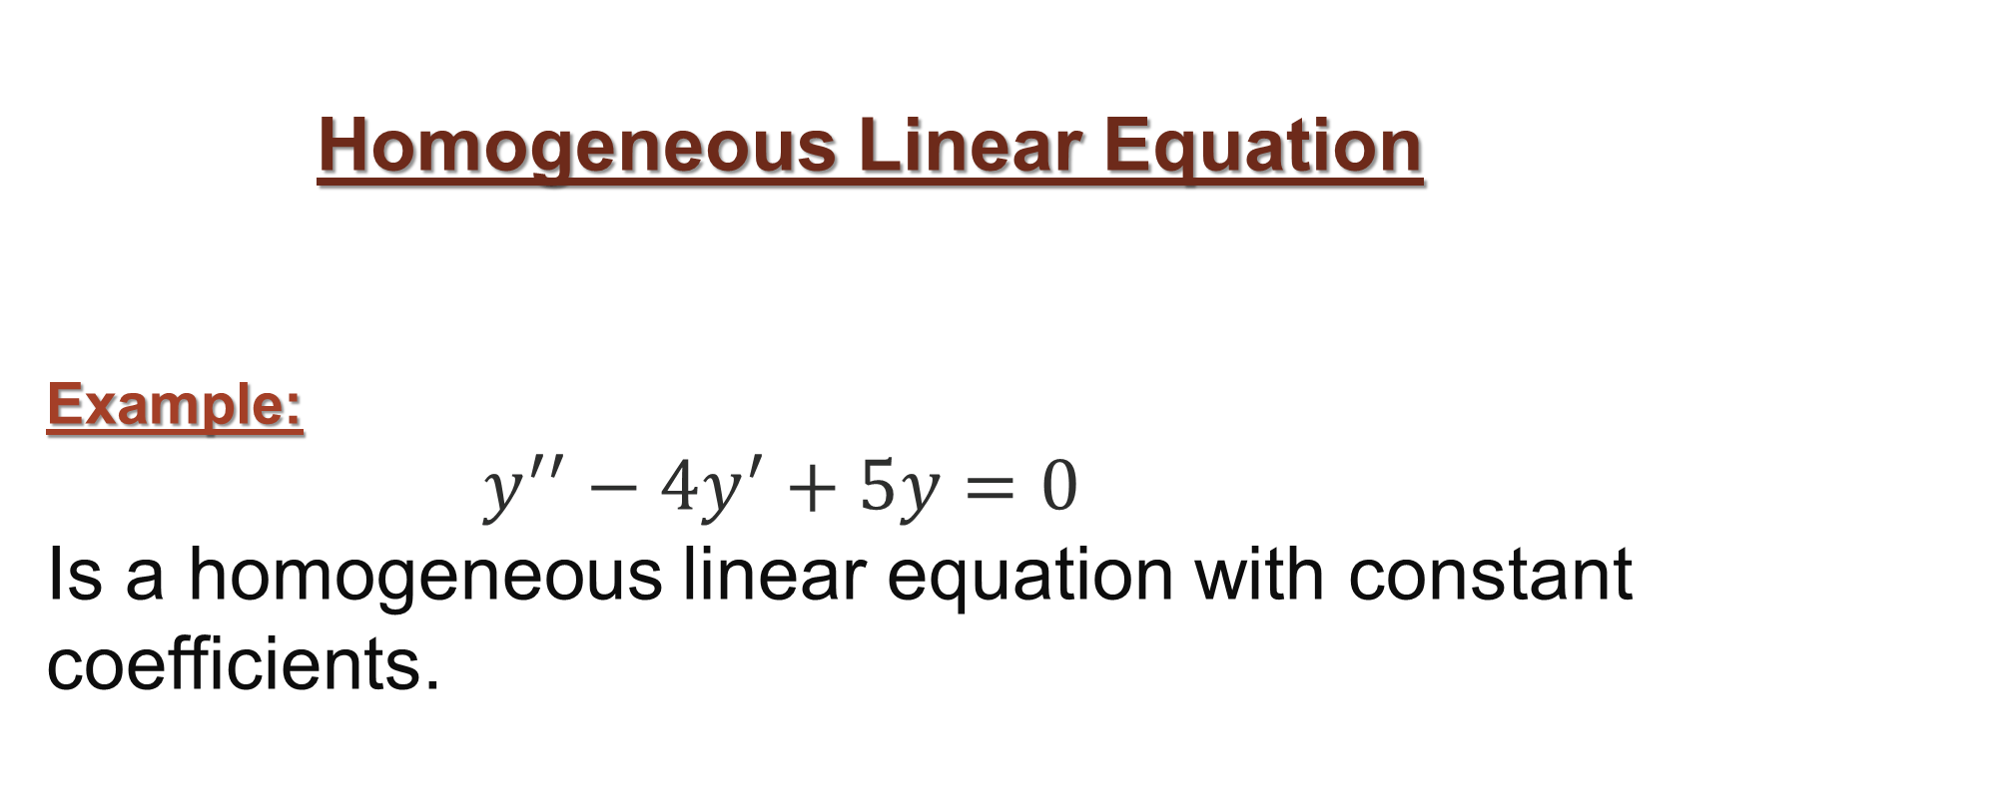
Homogeneous Linear Equation
Example:
$y^{′′}−4y^{′}+5y=0$
Is a homogeneous linear equation with constant coefficients.

Slide 3
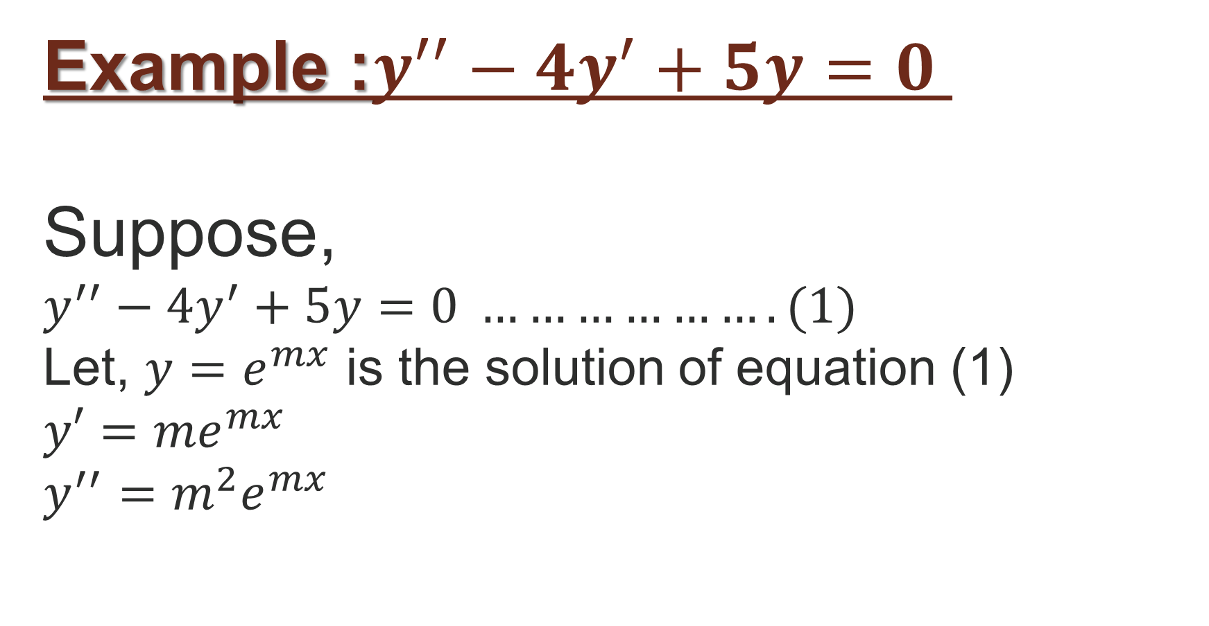
Example :$y^{′′}−4y^{′}+5y=0$
Suppose,
$y^{′′}−4y^{′}+5y=0 ……………….(1)$
Let, $y=e^{mx}$ is the solution of equation (1)
$y′={me}^{mx}$
$y^{′′}=m^{2}e^{mx}$

Slide 4
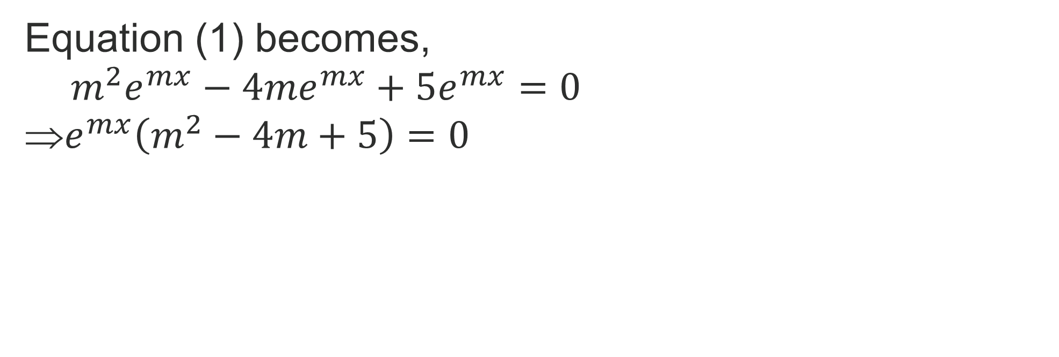
Equation (1) becomes,
$$m^{2}e^{mx}−4{me}^{mx}+5e^{mx}=0$$
$e^{mx}\left(m^{2}−4m+5\right)=0$

Slide 5
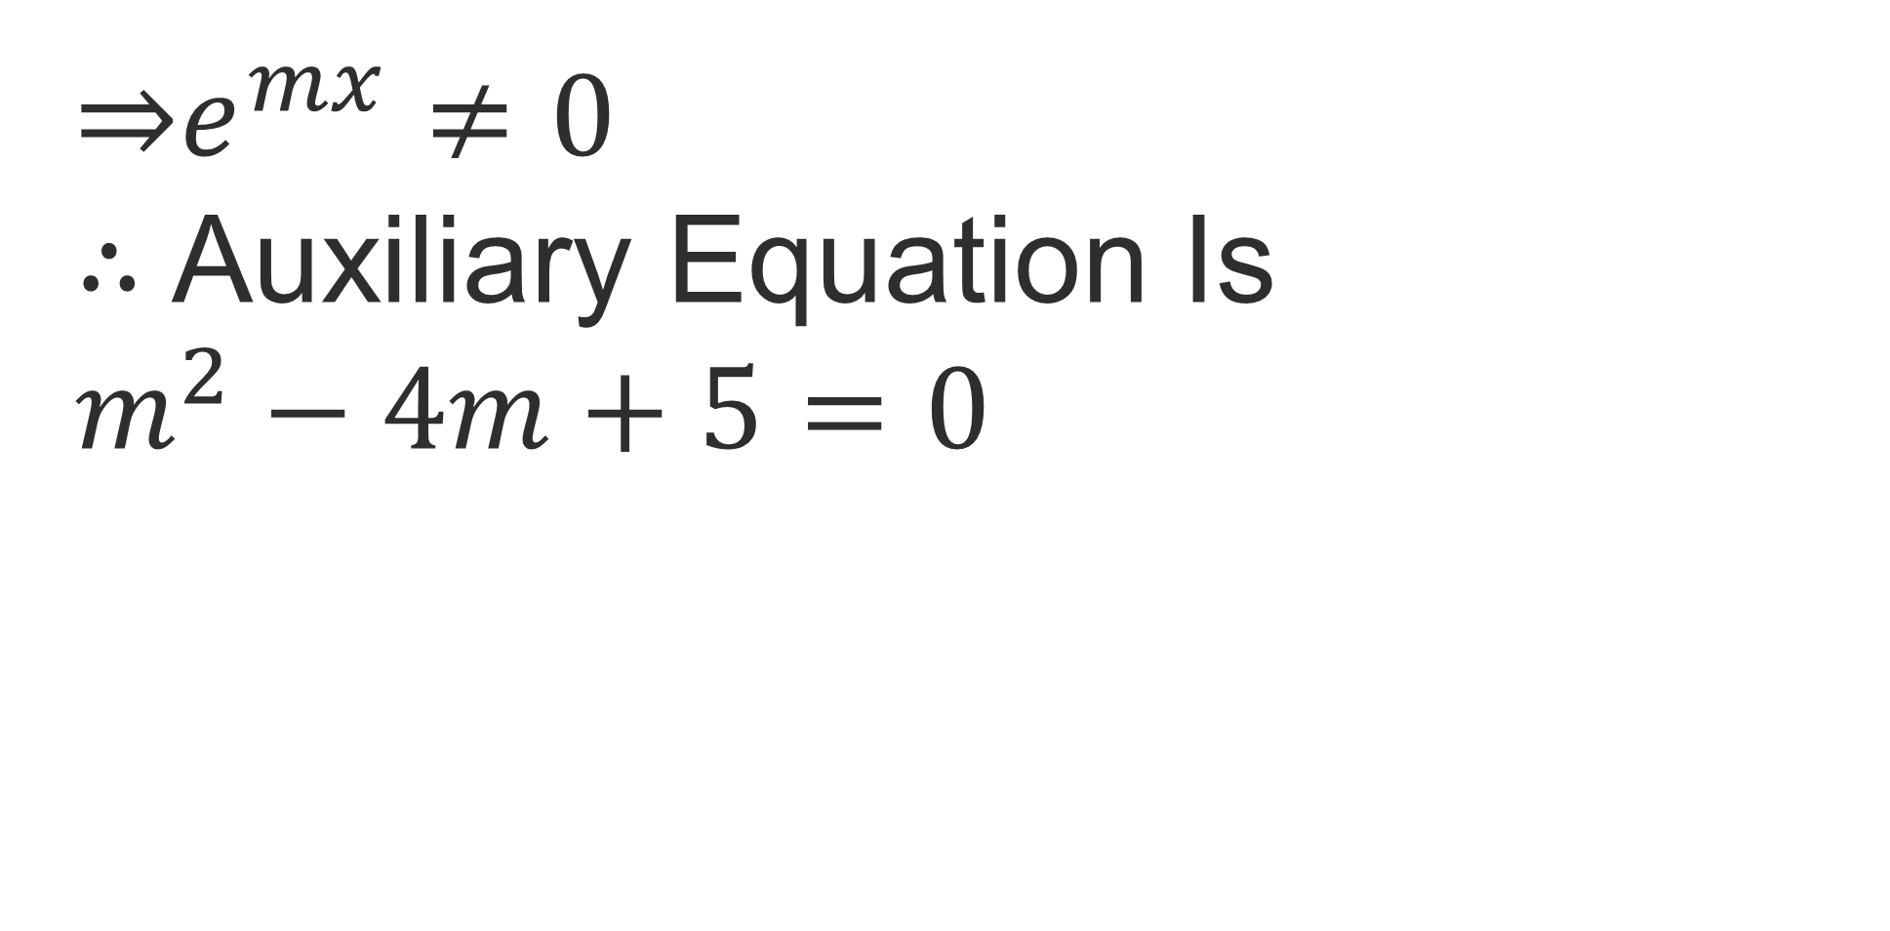
⇒$e^{mx}≠0$
$∴$ Auxiliary Equation Is
$m^{2}−4m+5=0$

Slide 6
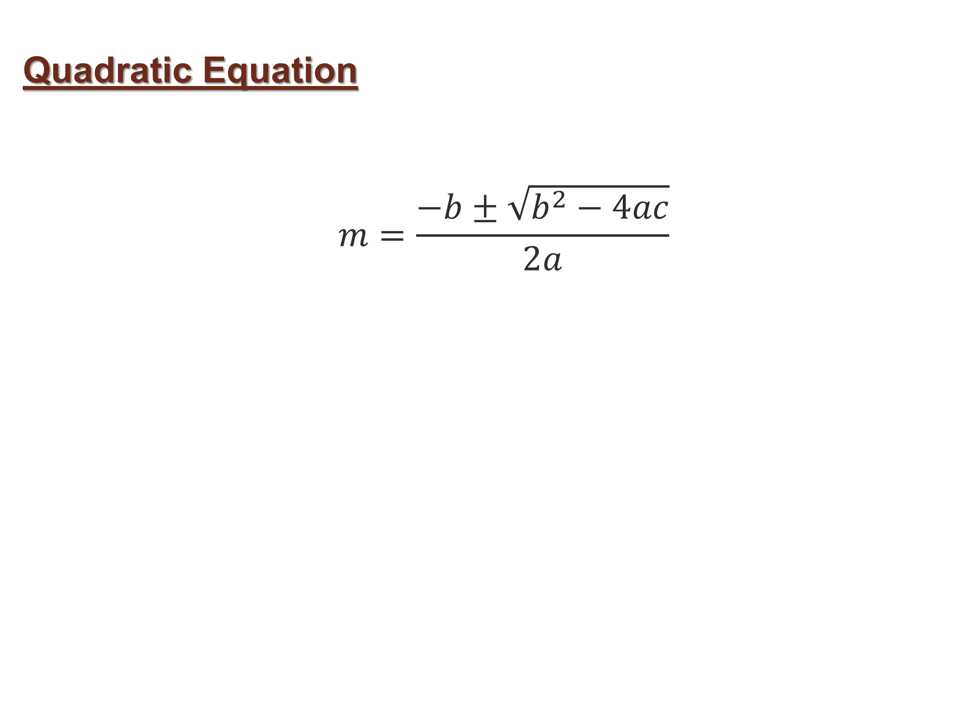
Quadratic Equation
$$m=\frac{−b±\sqrt{b^{2}−4ac}}{2a}$$

Slide 7
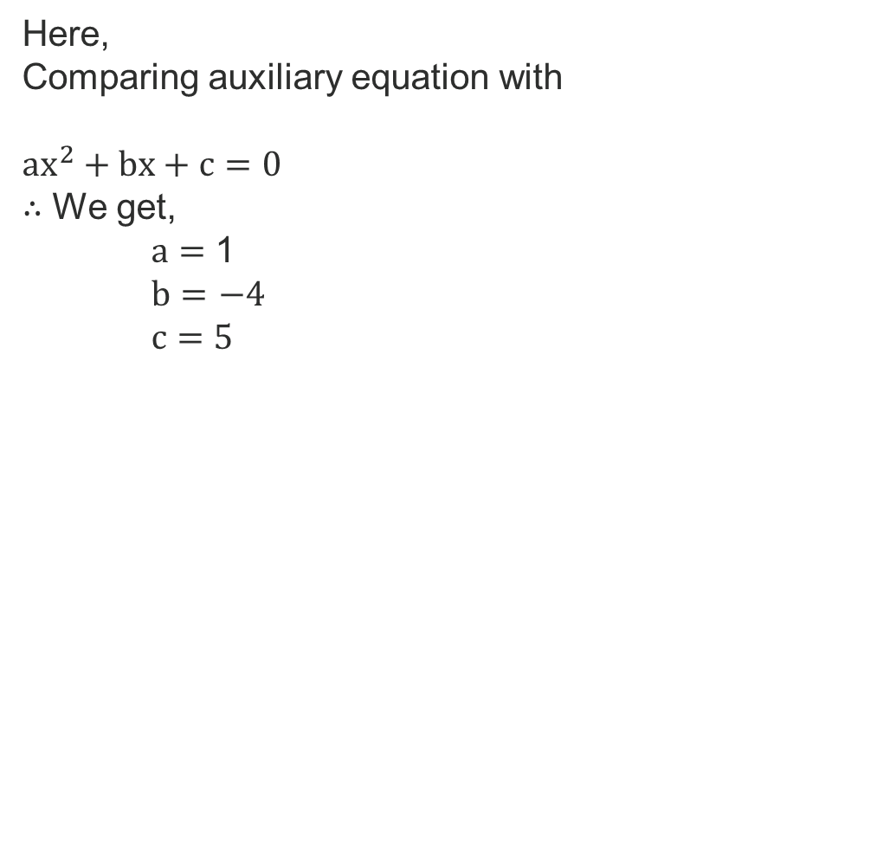
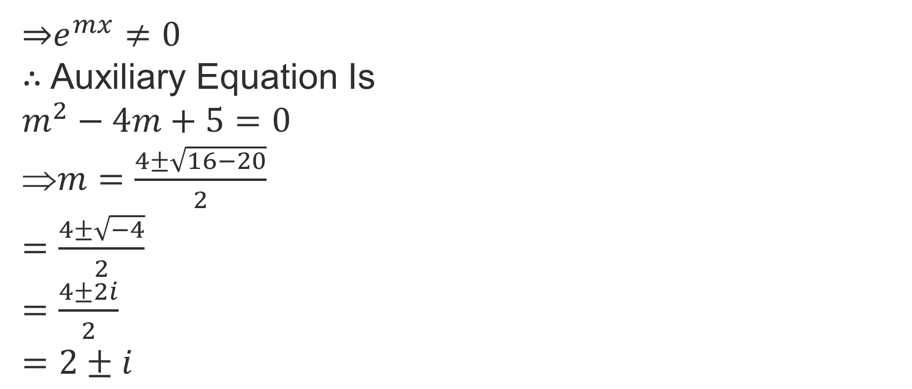
⇒$e^{mx}≠0$
$∴$ Auxiliary Equation Is
$m^{2}−4m+5=0$
$m=\frac{4±\sqrt{16−20}}{2}$
$=\frac{4±\sqrt{−4}}{2}$
$=\frac{4±2i}{2}$
$=2±i$
Here,
Comparing auxiliary equation with
${ax}^{2}+bx+c=0$
$∴$ We get,
$a$ $=$ 1
$b=$ $−4$
$c$ $=$ $5$

Slide 8
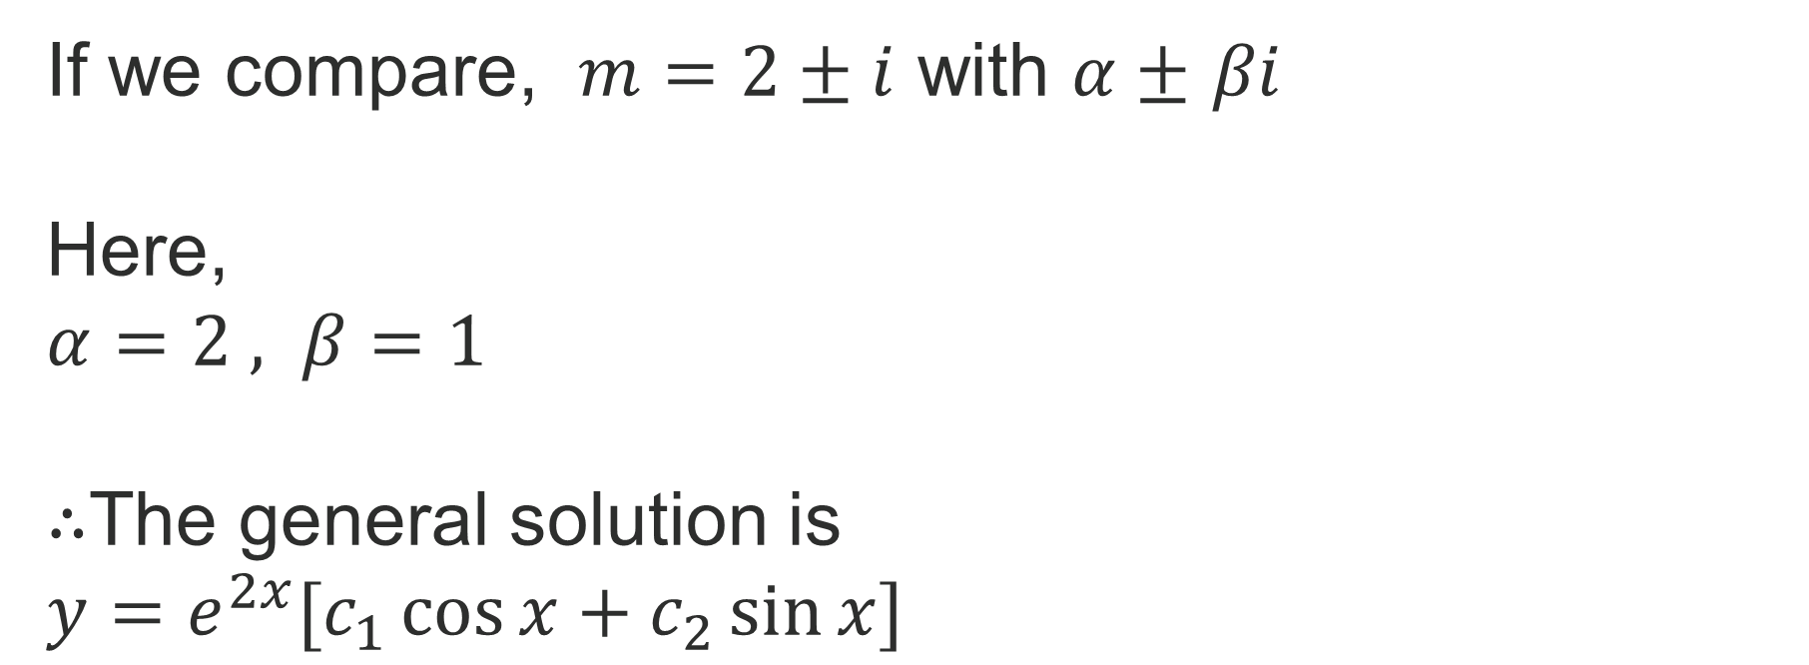
If we compare, $m$ $=2±i$ with $α±$ $βi$
Here,
$α=2 , β=1$
$∴$The general solution is
$y=e^{2x}[c_{1}\cos{x}+c_{2}\sin{x}]$

Slide 9
Quadratic Equation
$$m=\frac{−b±\sqrt{b^{2}−4ac}}{2a}$$

Slide 10
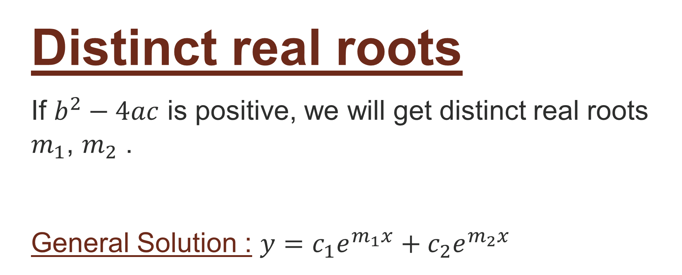
Distinct real roots
If $b^{2}−4ac$ is positive, we will get distinct real roots $m_{1}$, $m_{2}$ .
General Solution : $y=c_{1}e^{m_{1}x}+c_{2}e^{m_{2}x}$

Slide 11
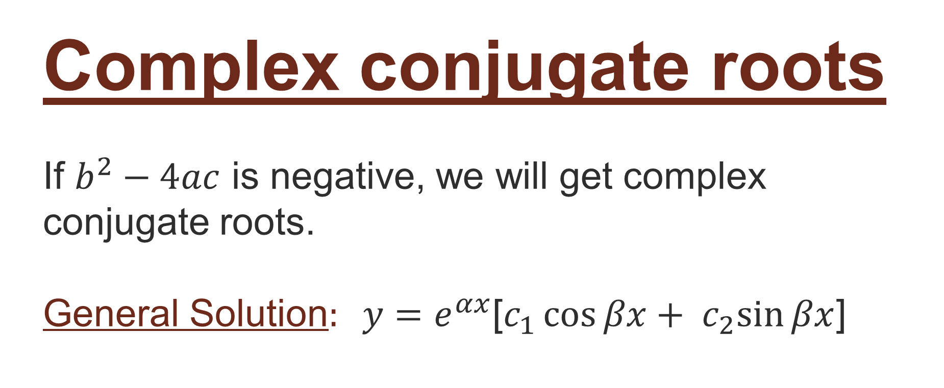
Complex conjugate roots
If $b^{2}−4ac$ is negative, we will get complex conjugate roots.
General Solution$: y=e^{αx}$[$c_{1}\cos{βx}+ c_{2}sin{βx}$]

Slide 12
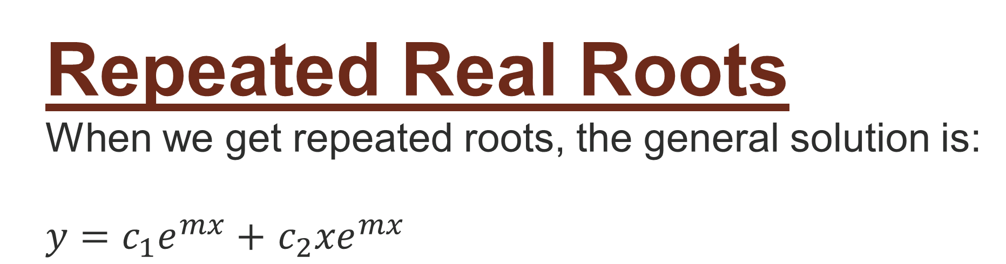
Repeated Real Roots
When we get repeated roots, the general solution is:
$y=c_{1}e^{mx}+$ $c_{2}{xe}^{mx}$

Slide 13
Thank You

